Slide 1
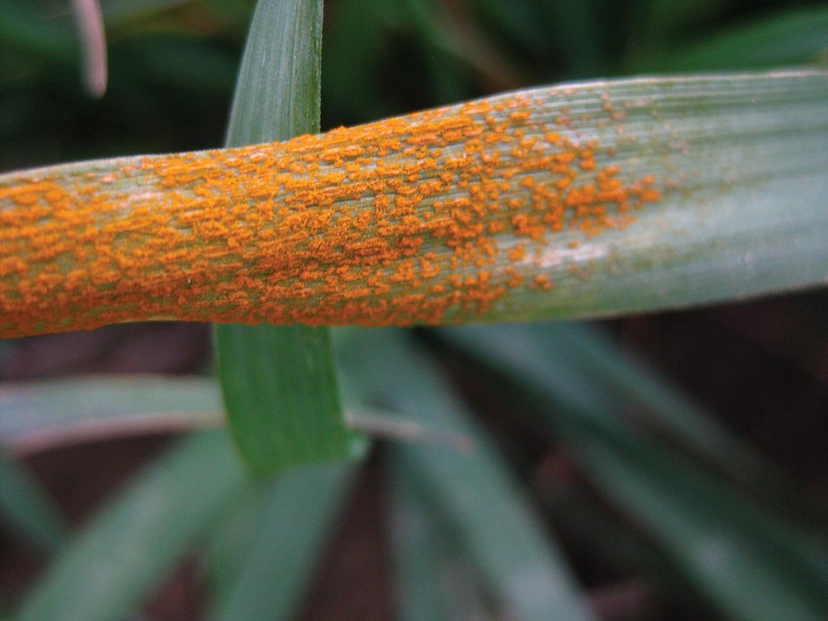
Exploring Metagenomics For Rapid Diagnosis of Coinfection in Plants
Gamran Green, Andrew Milgate, John rathjen, Benjamin Schwessinger
Anu Summer Scholarship PROJECT, 2016-2017

Slide 2
Introduction
‘Coinfection’:
- Simultaneous infections by two or more pathogens.
Unpredictable consequences for plant:
- Biological, Morphological
- Can complicate diagnosis
Correct Diagnosis → Proper Disease Control Industry interest in Rapid, On-Site Diagnosis

Slide 3
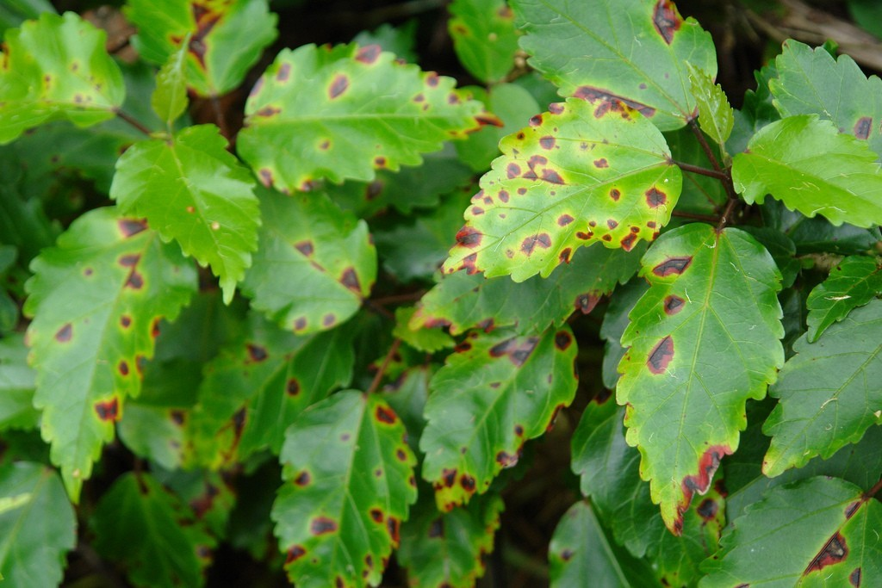
Identifying Plant Disease (1)
Physical Methods
Predict from morphology:
Characteristics
Distribution
Variability
Macroscopic Causal Agents
PREDICTIVE | EXPERTISE-BASED

Slide 4
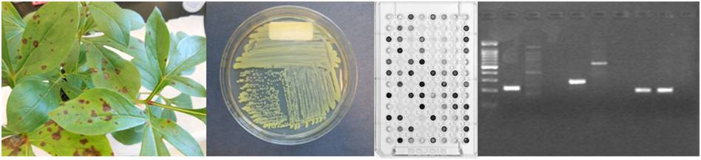
Identifying Plant Disease (2)
Molecular Methods
PCR
ELISA
Markers: - DNA, Biochemical
SLOW | EXPENSIVE | SPECIFIC

Slide 5
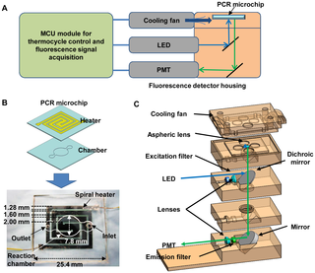
Identifying Plant Disease (3)
Current Methods
Expert Systems
Microchip, RCA PCR
EM + Irradiation (Viruses)
Metagenomics
RAPID | CHEAP | FLEXIBLE

Slide 6
Metagenomics
‘Study of genetic material from environmental samples’
NON-SPECIFIC:
Detect gDNA from all organism types (including host)
Understand the microbiome
RECENT ACCESSBILITY:
Cheaper gDNA prep methods
Portable whole-genome sequencing (Nanopore MinION)
Extensive genome databases (NCBI)
Efficient database matching algorithms (BLAST)

Slide 7
Methods

Slide 8

Samples:
UNINFECTED
?
?
?
?
?
1
2
3
4
5
6
1D PCR barcoding
Whole-genome shotgun sequencing (MinION)
Read distribution analysis
Metagenomics and taxonomic analysis
Experiment conducted BLIND
Infecting species verified post-analysis
PURIFIED
GENOMIC
DNA

Slide 9
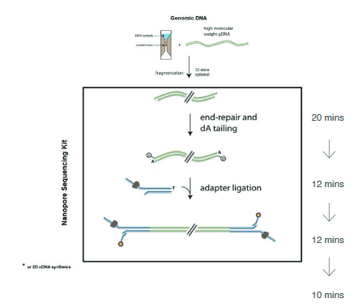
DNA Preparation
1D PCR Barcoding Kit
‘Barcodes’ ligated to sheared gDNA
→ Samples labelled as BC01 - BC06
Allows:
- gDNA amplification (PCR)
- Sample differentiation
- 1D Nanopore Sequencing

Slide 10
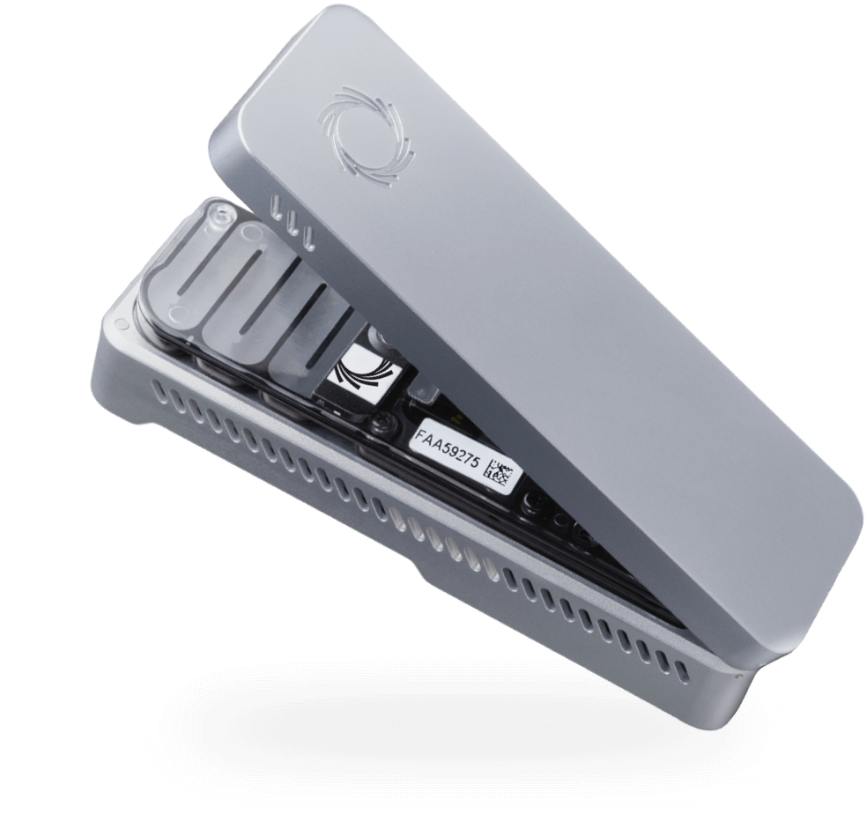
The MinION
PORTABLE
(~100g)
PARALLEL SEQUENCING
(~128 pores)
LONG READ INTEGRITY
(~200kB max. reported)

Slide 11
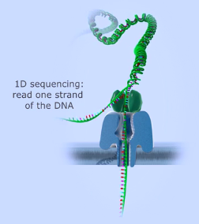

1D Sequencing and Basecalling
1D Sequencing:
- In: dsDNA (all barcodes pooled)
- Out: sequenced ssDNA
~ 80-90% accuracy (MinION)
993141 Reads Detected
Metrichor Basecalling:
- Fail/Pass Quality Control Platform
628102 Reads Passed

Slide 12
Read Distribution Analysis

Slide 13
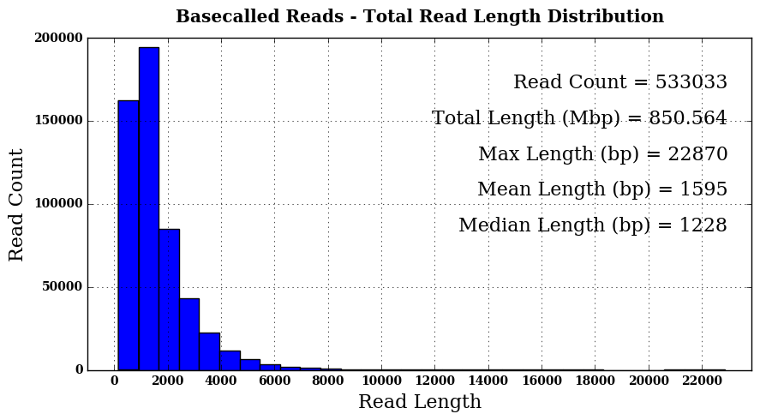
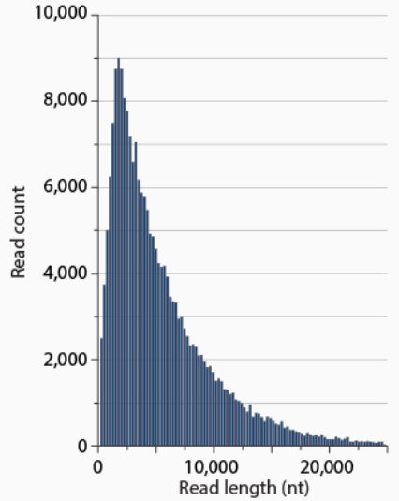
Typical 1D gDNA Nanopore Distribution
533033 Reads Extracted For Analysis

Slide 14
Comments on Read Distribution
BC01 & BC06 were noted as duplicate samples: - Combined here under ‘BC01’
The barcoding process was imperfect: - Some reads sorted as BC07 - BC99 and NB01 - NB12 → Combined here under ‘NB00’ BC03 & NB00 had notably lower read counts.
BC01 had a comparatively lower median.

Slide 15
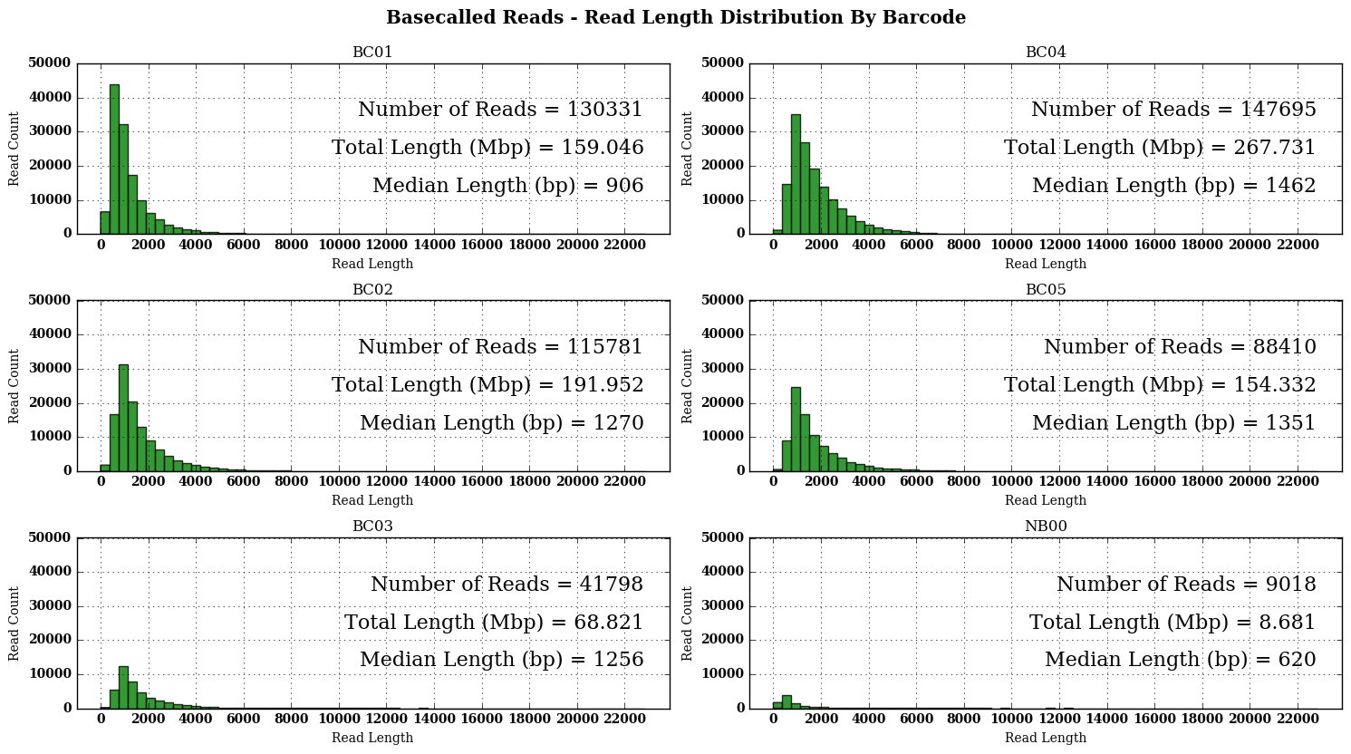

Slide 16
Metagenomics Analyses

Slide 17
Approaches
1) BLAST against reference genomes (suggested by sample suppliers):
- Wheat – HOST
- P. striformis f. sp. tritici WA – Wheat stripe rust - Parastagonospora nodorum – Stagonospora nodorum blotch - Pyrenophore tritici-repentis – Tan spot - Zymoseptoria tritici – Septoria tritici blotch 2) IF NO HIT → BLAST against entire NCBI database.

Slide 18
Reference Genome BLAST

Slide 19
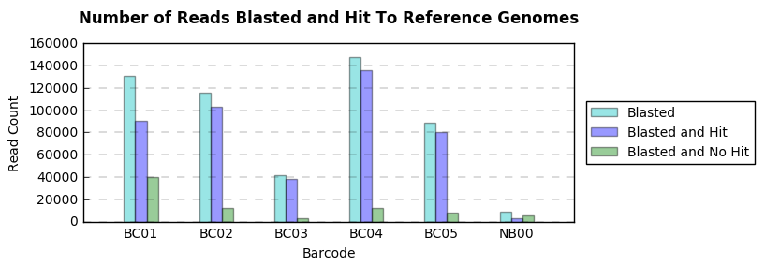
451569 (or ~84.7%)
BASECALLED READS HIT
REFERENCE GENOMES
~90% hit within BC02 – BC05
~70% hit within BC01
~40% hit within NB00

Slide 20
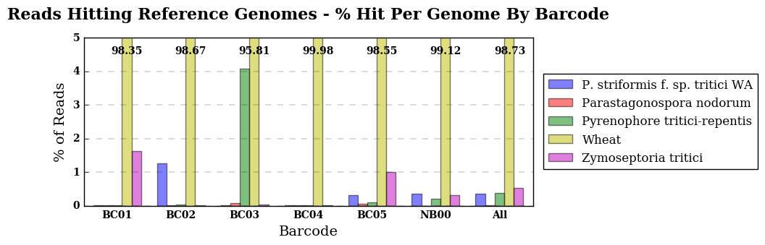
Most reference genome hits were Wheat - the host (~98% across all barcodes)
BC01, BC02 & BC03 results suggested infection by a single pathogen
BC04 results suggested no infection (the control)
BC05 gDNA suggested coinfection with Pst and Zymo

Slide 21
Comments on Reference Genome Analysis
Cross-check with sample supplier identifications: → BC01 – BC05 data seems to correlate correctly
Parastagonospora was a negative control – no infection across samples - Reads found in BC03 & BC05: Inaccuracy? Previously undetected?
Most species present in NB00 (except Para): - Suggests faulty barcoding of reads.
BC05 Coinfection: Zymo → Clear | Pst → NOT AS CLEAR - Potential to MISS or MISDIAGNOSE SPECIES?

Slide 22
NCBI Database BLAST

Slide 23
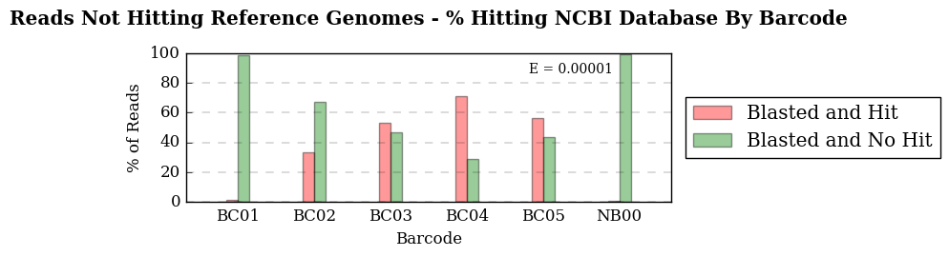
81464 (or ~15.2%)
BASECALLED READS
NOT HITTING
REFERENCE GENOMES
22905 (or ~28.1%)
UNSUCCESFUL RG HITS
HITTING NCBI
~60% hit within BC03 – BC05
~30% hit within BC02
~0% hit within BC01 & NB00

Slide 24
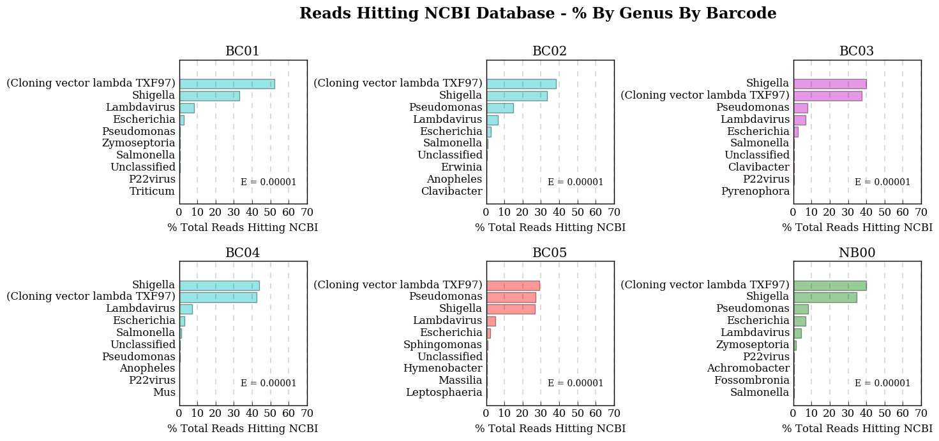
Zymo
Pst
Pyre
Pst + Zymo
NC
Common: Shigella, Pseudomonas, Lambdavirus, Escherichia, TXF97

Slide 25
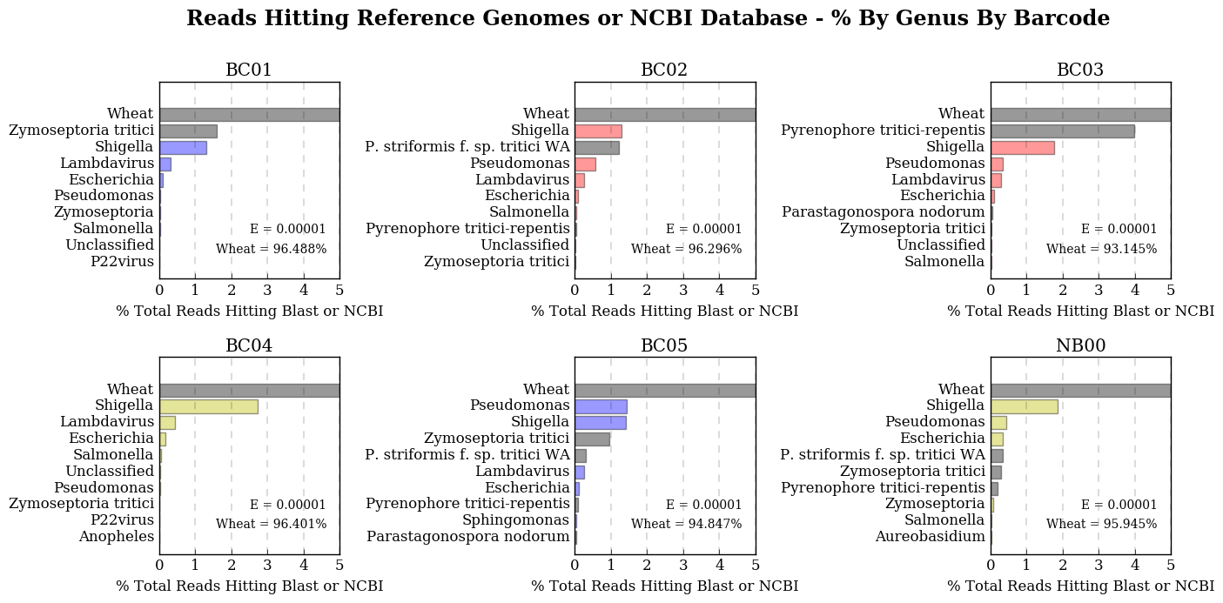
Common: Shigella, Pseudomonas, Lambdavirus, Escherichia ( - TXF97)

Slide 26
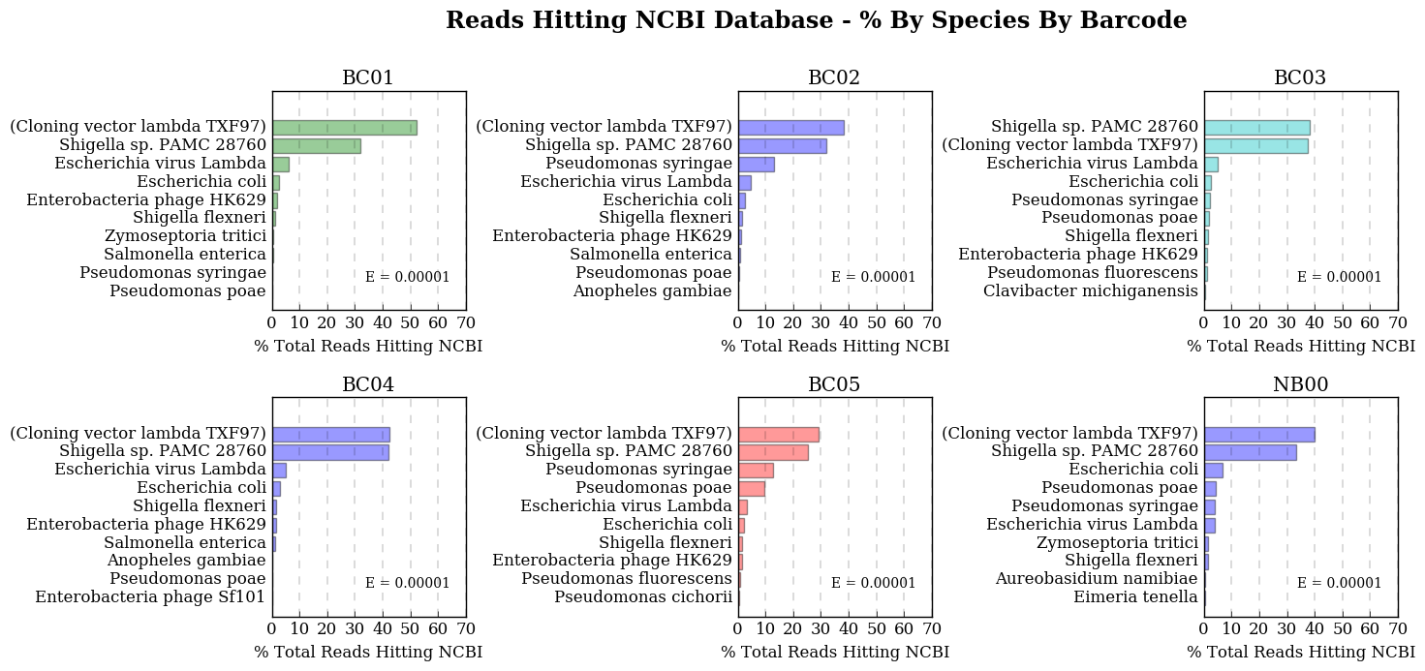
Zymo
Pst
Pyre
Pst + Zymo
NC
Common: Shigella (1 spp./str.), Pseudomonas (1-2 spp.), Lambdavirus, E. coli, TXF97

Slide 27
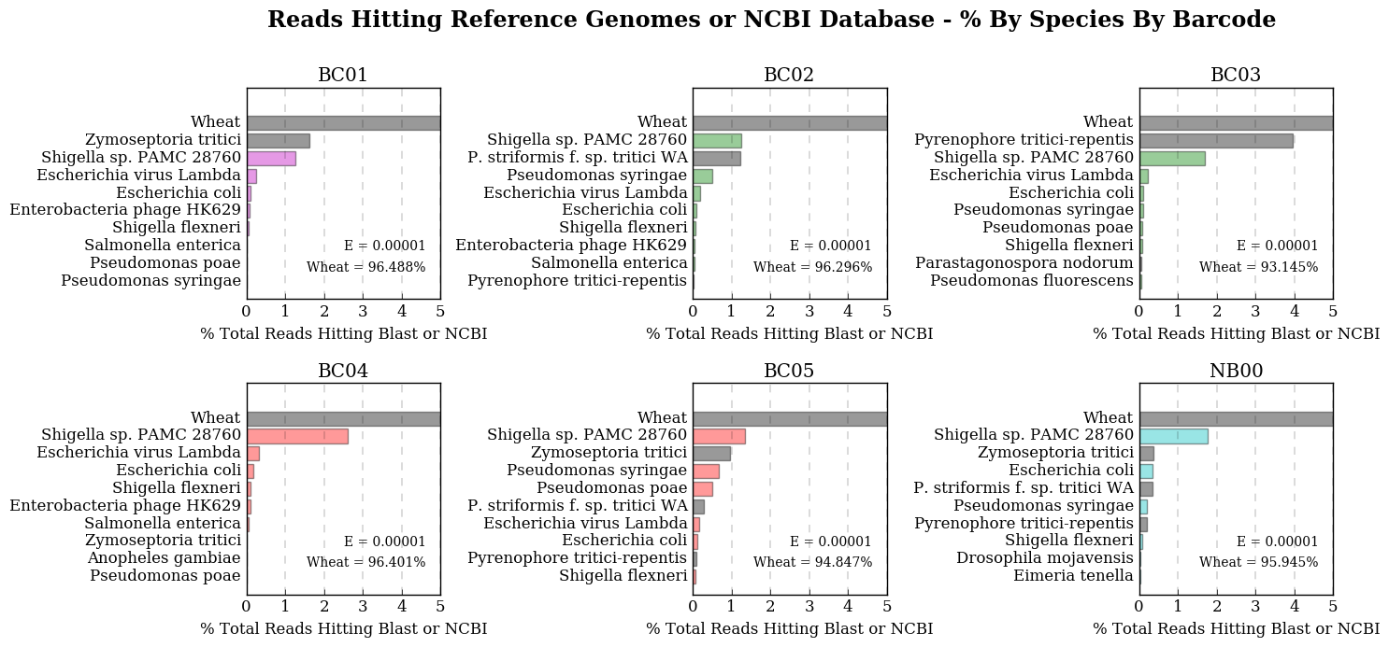
Common: Shigella (1 spp./str.), Pseudomonas (1-2 spp.), Lambdavirus, E. coli (- TXF97)

Slide 28
Comments on NCBI Database Analysis
‘Cloning Vector Lambda TXF97’ ,‘Shigella sp. PAMC 28760’ in all barcodes → Assumed to be contamination from sample transport (e.g. ice)
Common species: Pseudomonas, Escherichia - Known commensals on wheat crops and plants - Infecting species demonstrate similar read counts
Lack of hits in BC01: - Unique microorganisms? Junk DNA?
BC02 & BC05: - Pst infections seem to coincide with higher Pseudomonas populations

Slide 29
Discussion

Slide 30
Overall
Metagenomics-based methodologies showed:
- Successful identification of up to two simultaneous infections
- Correlation of increased Pseudomonas spp. growth with P. striformis f. sp. tritici WA infection.
- Potential adaptability for field analyses

Slide 31
Overall
Limitations:
ONLY DETECTS DATABASED ORGANISMS
LOW EFFICIENCY
HIGH PROCESSING POWER NEEDED
→ Requires streamlining for field applications…

Slide 32
Misc. Issues
Barcoding: → ~1.7% of basecalled reads classified as ‘NB00’ → Presence of most species in NB00 suggests faulty barcode ligation
MinION Process was finicky and took several days: - A crash necessitated a sequencing restart → Some reads failed to download post-analysis (628102 → 533033) - An air bubble clogged some MinION pores – reads missed?
BLAST speed varies: - Quick with reference genomes - NCBI searches take several days – impractical to use for all reads - Taxonomic analysis code is functional but slow!

Slide 33
Further Sample Analysis
Use of reference genomes – potentially BIASED? - Subsample reference genome hits for NCBI BLAST
Compare read count / species and relative genome size
Analysis of ‘Not Downloaded’ reads (~10% more data)
Reads hitting no database → ~11%! - EXAMINE. ‘Garbage’ DNA? Un-databased DNA?
BC01 – Run BLAST with higher E-Value

Slide 34
Further Research
Include more duplicates / sample
Test more samples, e.g: - other plant species (smaller genomes) - plants with more than two simultaneous infections
Optimize analysis pipeline: - Faster, more flexible code - New database-search algorithms e.g. k-SLAM

Slide 35
TO EVERYONE…
To my lab crew: Ben, John, Ram, Diana, Vero, Yiheng…
and all the others I’ve connected with.
THANK YOU FOR THIS
AMAZING EXPERIENCE ☺
YOU GUYS ARE THE BEST!!!

